Slide 1


Welcome!
Milestone 0
JS recap
Thursday, September 17, 2026
JS recap day 1 of 2
Notes:
R

Slide 2
01
04
02
05
03
06
Outline
Warm-Up
Break
Check in & “background check” 🤓
10 min
20 min
Setup
JS for React
10 min
45 min
methods, functions, DOM manipulation, localStorage
recap of JS basics
JS for React contd.
30 min
Next class
Data types, objects, arrays
promises, asynchronicity, fetch API
Notes:
Old:
14:00 - 15:00 Arrow
15:00 - 15:10 Break
15:10 - 16:00 forEach & co.
16:10 - 16:10 Break
16:10 - 17:00 Modules
New:
14:00 - 15:00 Arrow functions & destructuring => lecture
15:00 - 15:10 Break
15:15 - 15:50 Arrow functions & destructuring => exercises (40m)
15:50 - 15:55 Break (5m)
15:55 - 16:15 forEach & co. => theory (20m)
16:15 - 16:55 forEach & co. => exercises (40m)
16:55 - 17:00 Modules (5m)

Slide 3
01
Warm-Up
Check in & “background check” 🤓

Slide 4





Your Full-Stack Learning Journey
a roadmap with stepping stones and milestones
🎯 The Goal:
Learn Full-Stack Web Development → Junior Developer Role
The Path - Step by Step via Milestones 📍
Full-Stack (Next.js + MongoDB)
Frontend (React)
Polish (Tailwind CSS)
UI/UX
Mini Milestone 0 (JS Recap)
HTML/CSS
Making progress - one stepping stone at a time
Diverse backgrounds: HTML/CSS, JavaScript, UI/UX
Where you are: individually different
‹#›

Slide 5

01
Warm-Up
Where do we stand?
📊 Let’s take a poll!

Slide 6
01
Warm-Up
How far do we go in web design and functionality …
… using HTML/CSS and JS?
… before we need React?

Slide 7
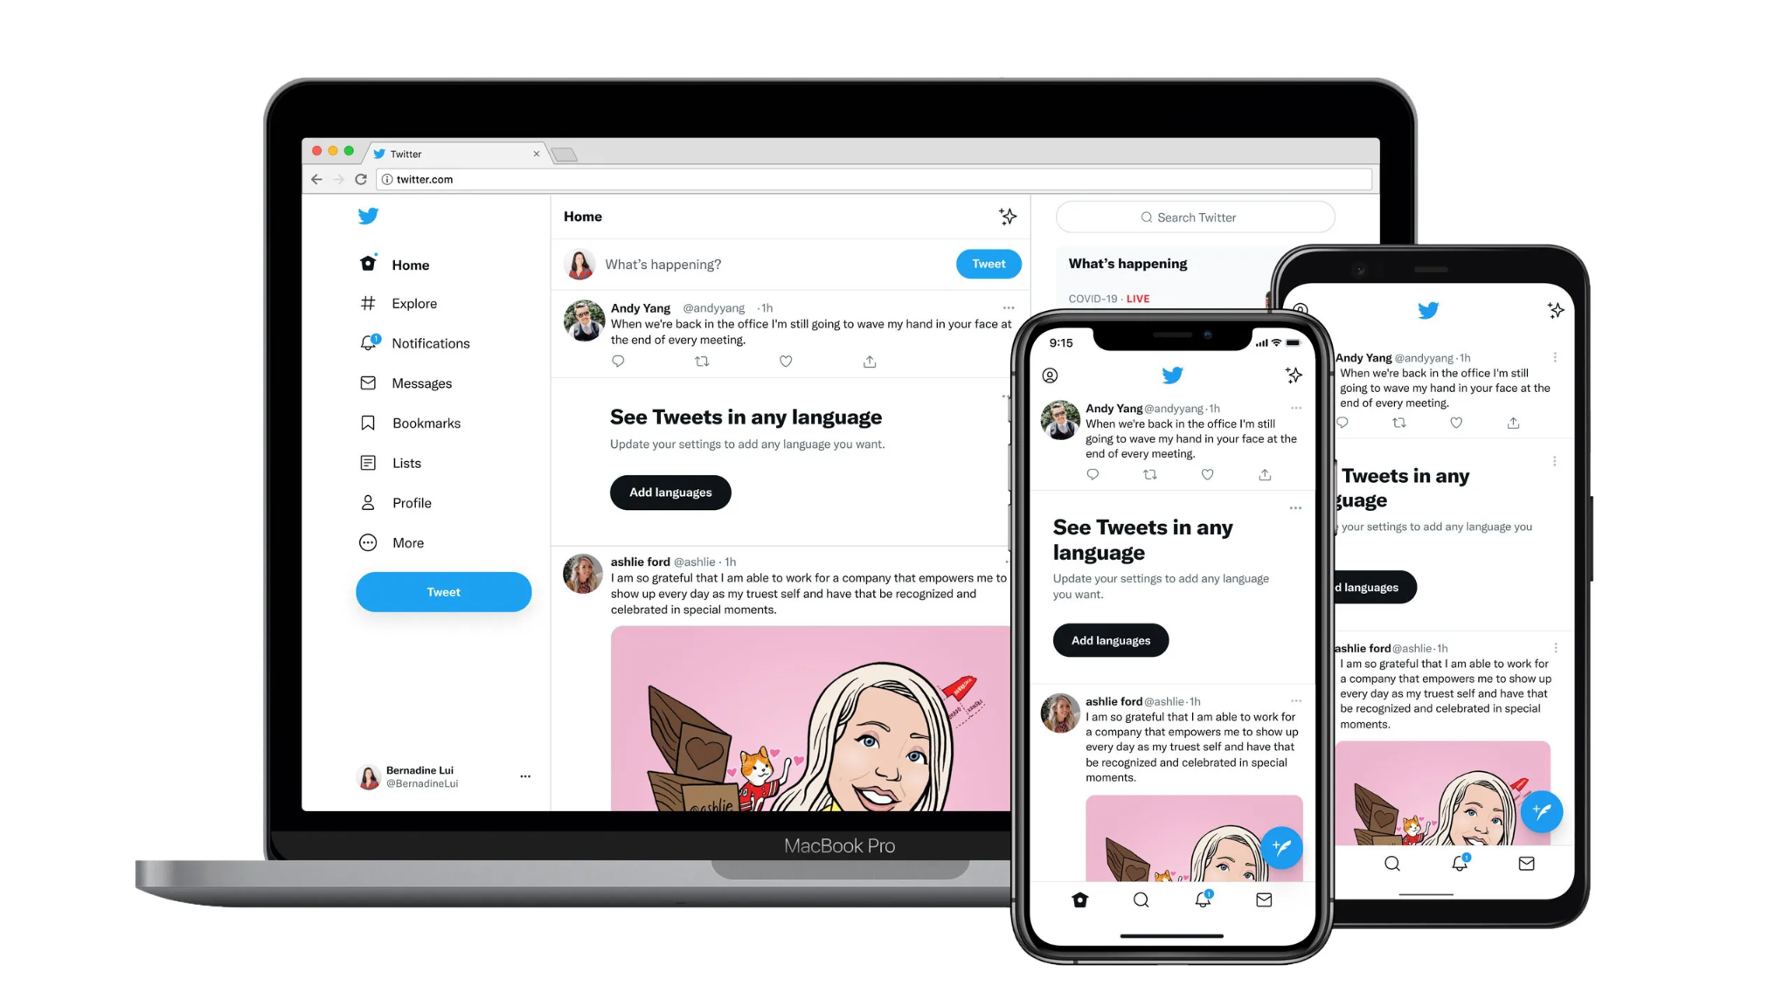
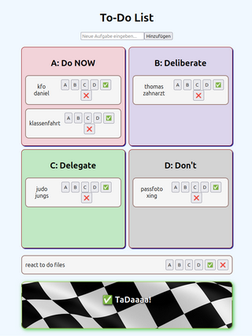
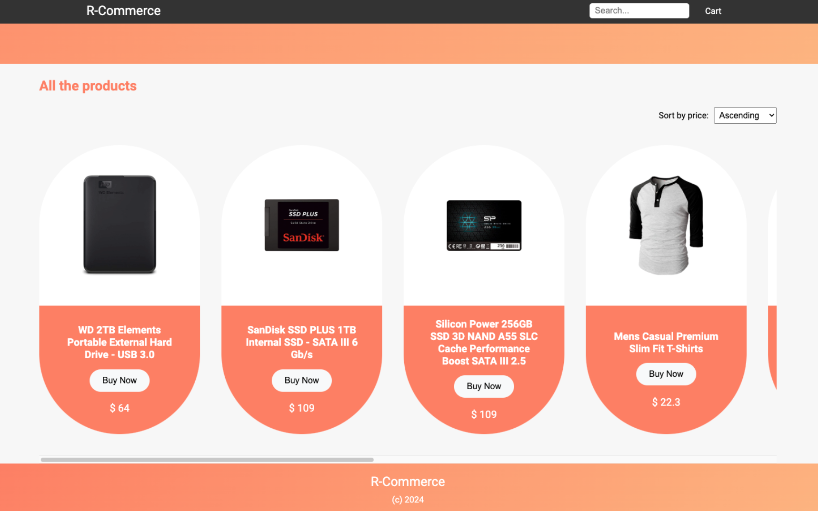
Course Topics - 2 projects
HTML/CSS with JS
xxxxx React xxxxxx
Full-stack web-app
Websites and web apps with responsive design, animations, interactions on the site, fetching data by APIs, persistence with localStorage…
Build an e-commerce with product listing, shopping cart, and dynamic filtering.
Create a clone of Twitter with tweet functionalities, user interactions and real-time updates
‹#›

Slide 8
02
Setup
Hardware & Software to use

Slide 9


02
Setup
We will use VSCode and GitHub
Visual Studio Code is a Code Editor
GitHub is used for version control of your projects (repositories - “repo’s”)

Slide 10
03
Recap of JS basics
Data types, objects, arrays
Markdown files:
README from the repo - the source of truth
Additional examples

Slide 11
03
JS basics
Data types
Objects
Arrays, spread operator
Array methods
… (to be continued)

Slide 12
04
Break!
🌬️
⏳️
☕️
See you again in 10 Minutes 😉
🚾
🏴‍☠️
surprise inside
Notes:
Go over Anil’s quiz

Slide 13

05
JS for React and Next.js
Methods, functions, promises, asynchronicity

Slide 14
05
JS for React
DOM manipulation
Promises
Asynchronicity
Fetching API
… localStorage, JSON to be continued…

Slide 15
Final questions?
🏴‍☠️
surprise inside
📸
❕let’s make a group picture 😁
Notes:
Go over Anil’s quiz

